Slide 1
Community Development and Community Well-Being:
Finding Points of Intersection and Building for the Future
ISQOLS Conference June 15th, 2018

Slide 2
Speakers
Rhonda Phillips
Craig Talmage
Kai Ludwigs
Dean of the Honors College and Purdue University
Author or editor of 24 books
Editor of a the series Community Quality of Life and Well-being, published by Springer in partnership with ISQOLS
ISQOLS President from 2015-2017
Current ISQOLS Board of Directors member
Visiting Assistant Professor of Entrepreneurial Studies and Hobart and William Smith Colleges
Community Development Society Former Vice President of Operations
Director of the Happiness Research Organization, an independent research institute based in Düsseldorf, Germany
Specializes in app-based studies with a focus in constructs such as satisfactions, subjective well-being, happiness, and quality-of-life
ISQOLS Executive Committee and Board of Directors member

Slide 3
CDS Innovative Community Engagement Grant
When? June 2017
The Community Innovation Lab teamed up with the Community Development Society to explore innovative community engagement methods
What happened?
Grants of $2,500 were given to five teams to promote community development:
Young Professionals & Graduate Students
International Communities
Urban Communities
Communities and Community Change
International Quality of Life Within Communities*
Special thanks to Dr. Dan Kahl and Dr. Kristina Hains for coordinating the program!
More information available at http://www.communityinnovationlab.org/cds-fellows-program/

Slide 4
Community Development and Community Well-Being: Finding Points of Intersection and Building for the Future
Project Description
Bringing together scholars and practitioners in community development and community well-being from two organizations: ISQOLS and CDS
Project Goals
Build capacity between the two organizations for exploring and strengthening understanding of community development and community well-being
Develop an online community project
Bring together members and students
Increase awareness and application
Assess the impact of this project

Slide 5
Organization Partnership
The International Society for Quality of Life Studies (ISQOLS)
Community Development Society
An international society whose purpose is to promote and encourage research in the field of quality-of-life (QOL) studies
The Community Development Society provides leadership to professionals and citizens across the spectrum of community development

Slide 6
ISQOLS and CDS have common goals (Overview)
ISQOLS
To be leaders in assessing QOL in communities and other groups
To develop partnerships across academic disciplines and other sectors in which QOL research takes place
To develop links with organizations and researchers associated with QOL studies world-wide
To play a role of a social change agent to bring about policies to foster QOL of various segments of society based on solid scientific study of QOL.
CDS
To enable communities to meaningfully influence the decisions that affect their lives
To engage community members in learning about and understanding community issues
-AND to help communities understand the impacts and outcomes of the different ways they could take action
To work to enhance the leadership capacity of community members, leaders, and groups within the community
To work toward the long-term sustainability and well-being of the community, while being open-minded to the full range of potential action strategies
Notes:
Leadership in QOL research enables community leaders to best enhance QOL and wellbeing in communities

Slide 7
Common Goals – ISQOLS (details)
ISQOLS
To assume leadership in academic circles to identify the impact of products, programs, services, organizations, and/or institutions on the QOL of society and certain groups, such as communities, countries, etc.
To play a role of a social change agent
-To bring about policies to foster QOL of various segments of society based on solid, scientific study of QOL
To develop closer liaisons with other organizations associated with quality of life studies to help develop a network of QOL researchers and organizations world-wide
To develop closer liaisons across academic disciplines, such as:
Marketing
Management
Economics
Sociology
Psychology
Community Development
Communications
Political Science
Hospitality
Housing
Education
Public administration
Health Care
Environmental Sciences
Medical sciences
AND others where QOL research is being pursued

Slide 8
Common Goals – CDS (details)
CDS
Promote active and representative participation toward enabling all community members to meaningfully influence the decisions that affect their lives.
Engage community members in learning about and understanding community issues, and the economic, social, environmental, political, psychological, and other impacts associated with alternative courses of action
Work actively to enhance the leadership capacity of community members, leaders, and groups within the community
Use the full range of action strategies to work toward the long-term sustainability and well being of the community.

Slide 9
Can we collaborate in the ”new” framework of community well-being?
+

Slide 10
What Does Collaboration Mean?
ISQOLS:
Provide knowledge of community well-being indicators
CDS:
Provide knowledge of community development types
Outcome:
Improved community development models and metrics
Notes:
Lovely graphic!

Slide 11
Examples of Collaboration
Representation Allocate at least one joint ISQOLS/CDS session at future ISQOLS and CDS conferences
Incentives ISQOLS works with CDS to offer its members (who are interested in community well-being issues) incentives to join CDS, and vice versa
Community Indicator Research Workshops Encourage CDS members interested in community well-being indicators to take ISQOLS training workshops and certification in community indicators research, and vice versa
Information Highlights Both societies include news that are pertinent to their respective members in their newsletters and websites
Journals Develop two journal articles based on this project, to be submitted to both organization’s journals (Applied Research in Quality of Life and Community Development) and/or in CD Practice or SINET (both organizations’ professional publications)
Networking Propose a track in each conference to help generate interest and disseminate results.

Slide 12
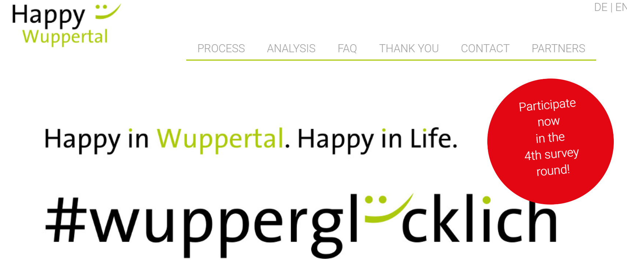
Collaboration in Practice: Happy Wuppertal App-Based Citizen Survey Happiness Research Organisation
www.Happy-Wuppertal.com
Video HERE
Notes:
Happy Wuppertal, Happiness Research Organisation Video: https://vimeo.com/217440623

Slide 13
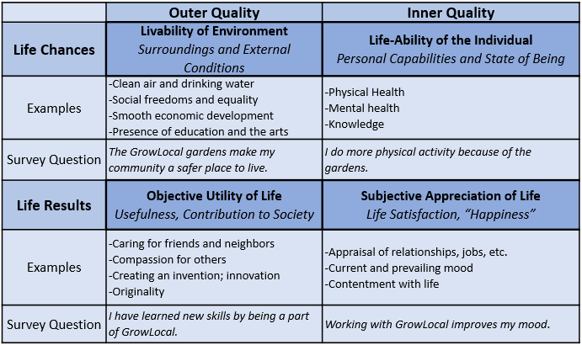
Student Engagement
Chelsea Maupin BSc Sustainable Food and Farming Systems
Jonathan Weir Graduate student
Table 1: Survey Question Framework adapted from Veenhoven, 2013.

